Slide 1
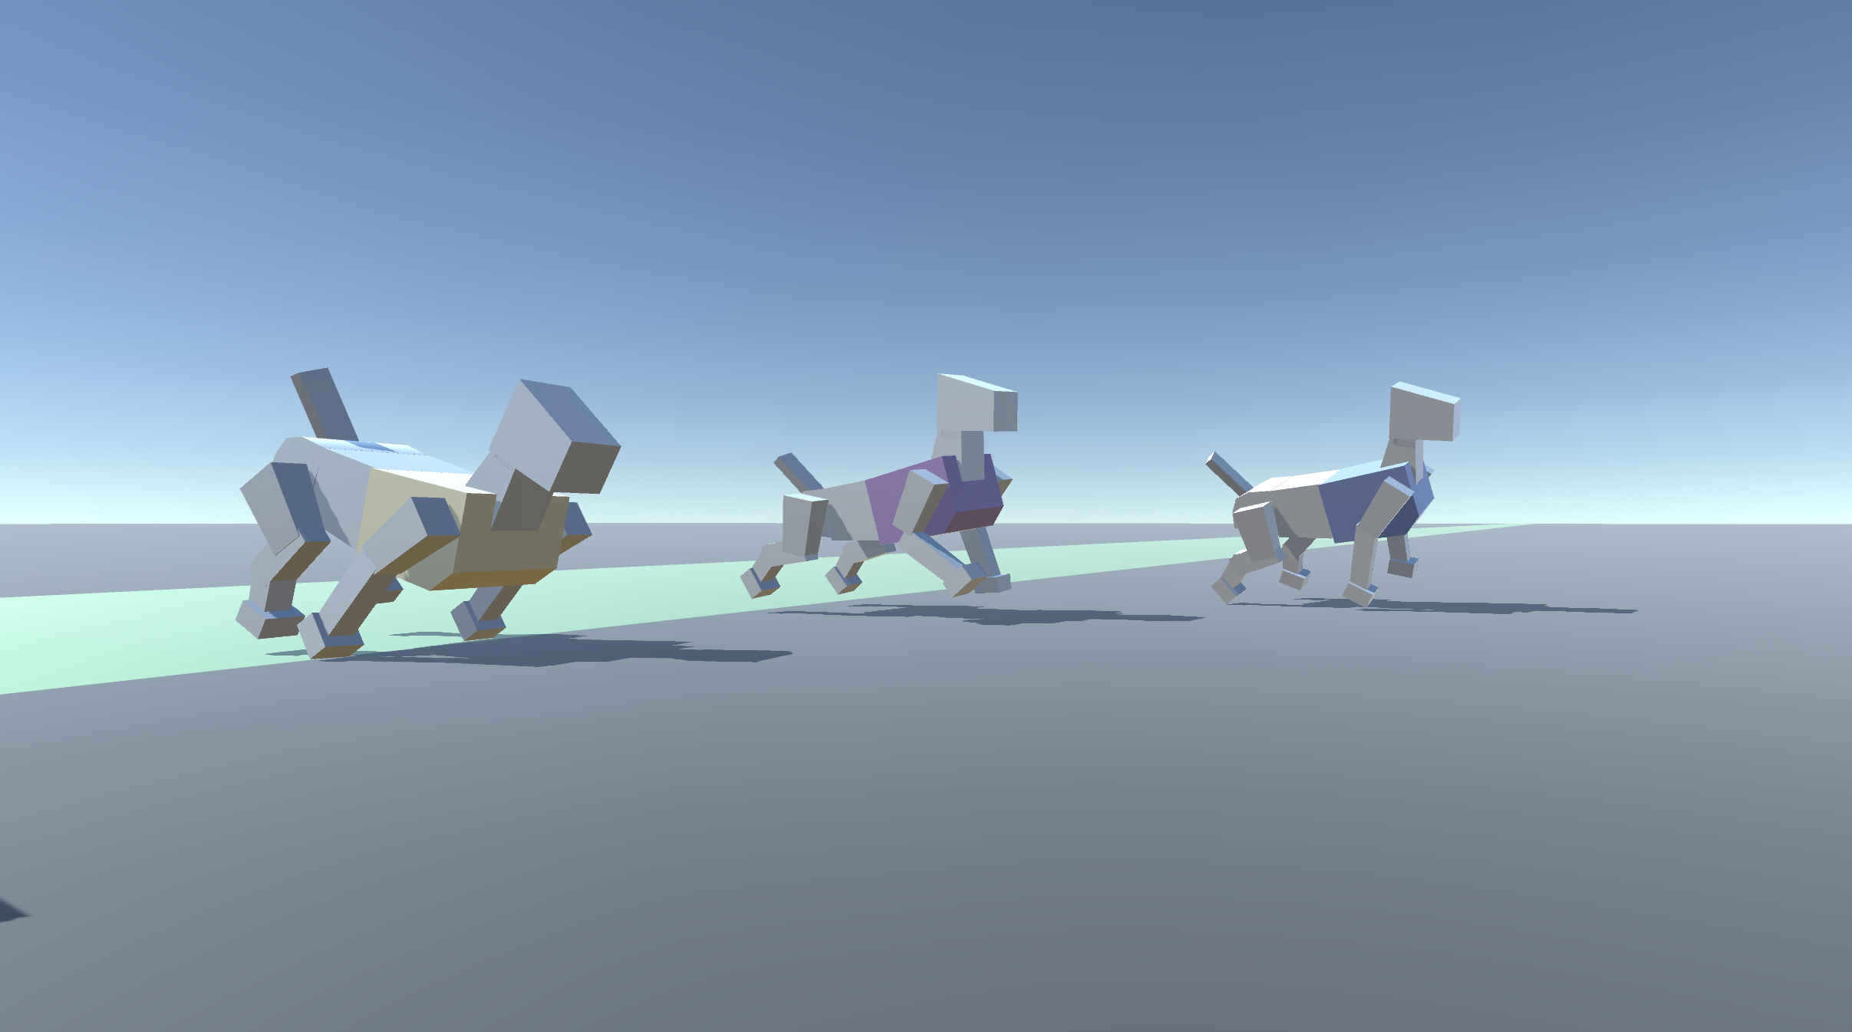
Machine Learning: First Steps
Learning to walk with genetic algorithms

Slide 2
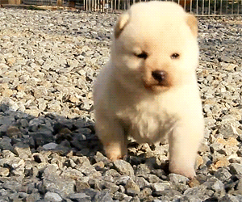
Teaching creatures to walk

Slide 3
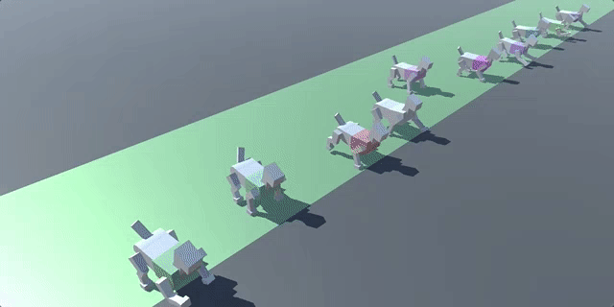
Emergent behaviour using left-right muscle pairings, 200 generations

Slide 4
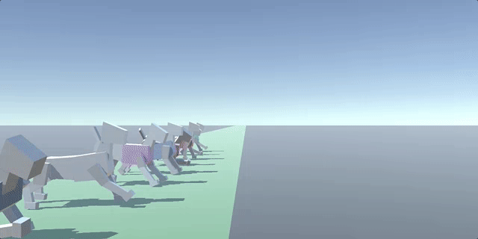
Fitness Score = distance + standing + head up
Best score starts next generation

Slide 5
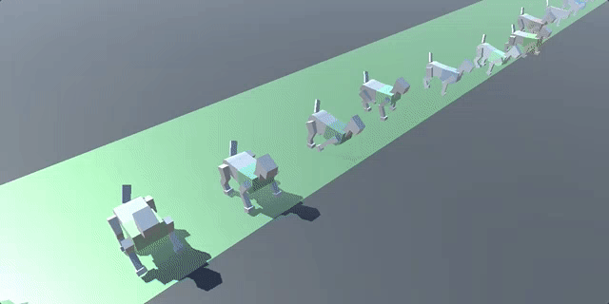
Emergent behaviour of no muscle pairings, start from standstill, 1000 generations

Slide 6
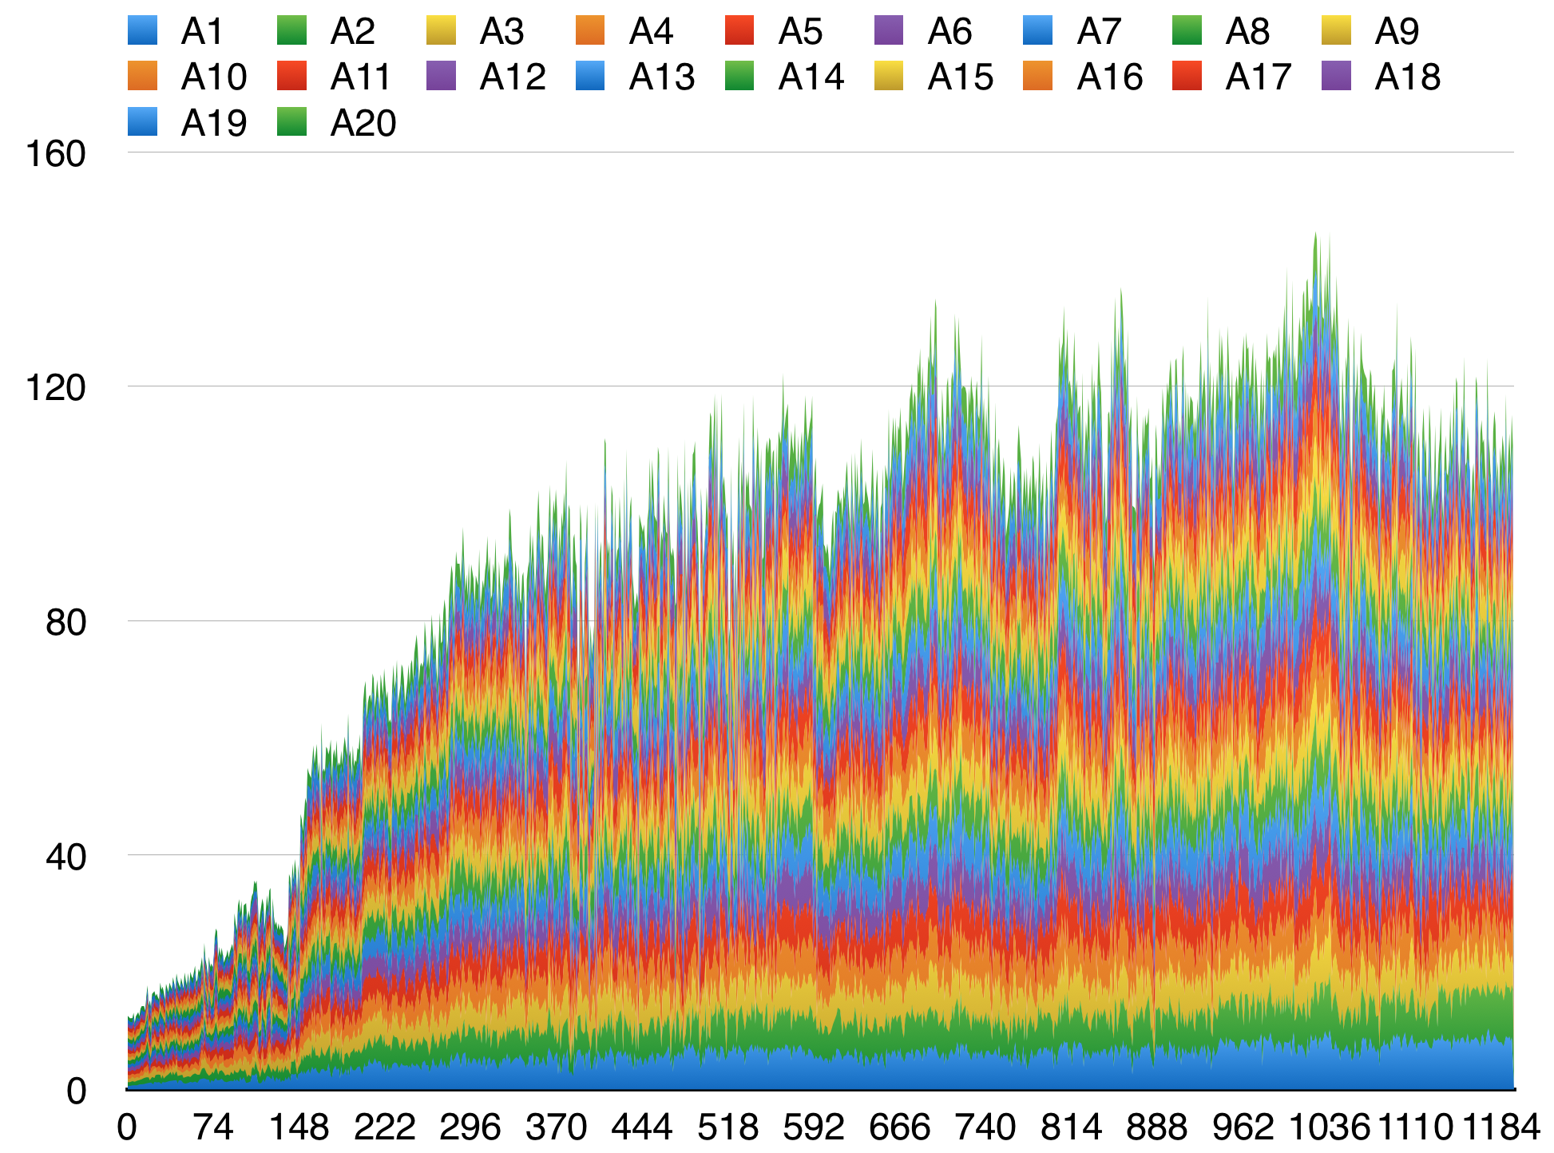
Fitness Score
For each dog (Ax)
per generation
Plateaus can be broken with a lucky mutation

Slide 7
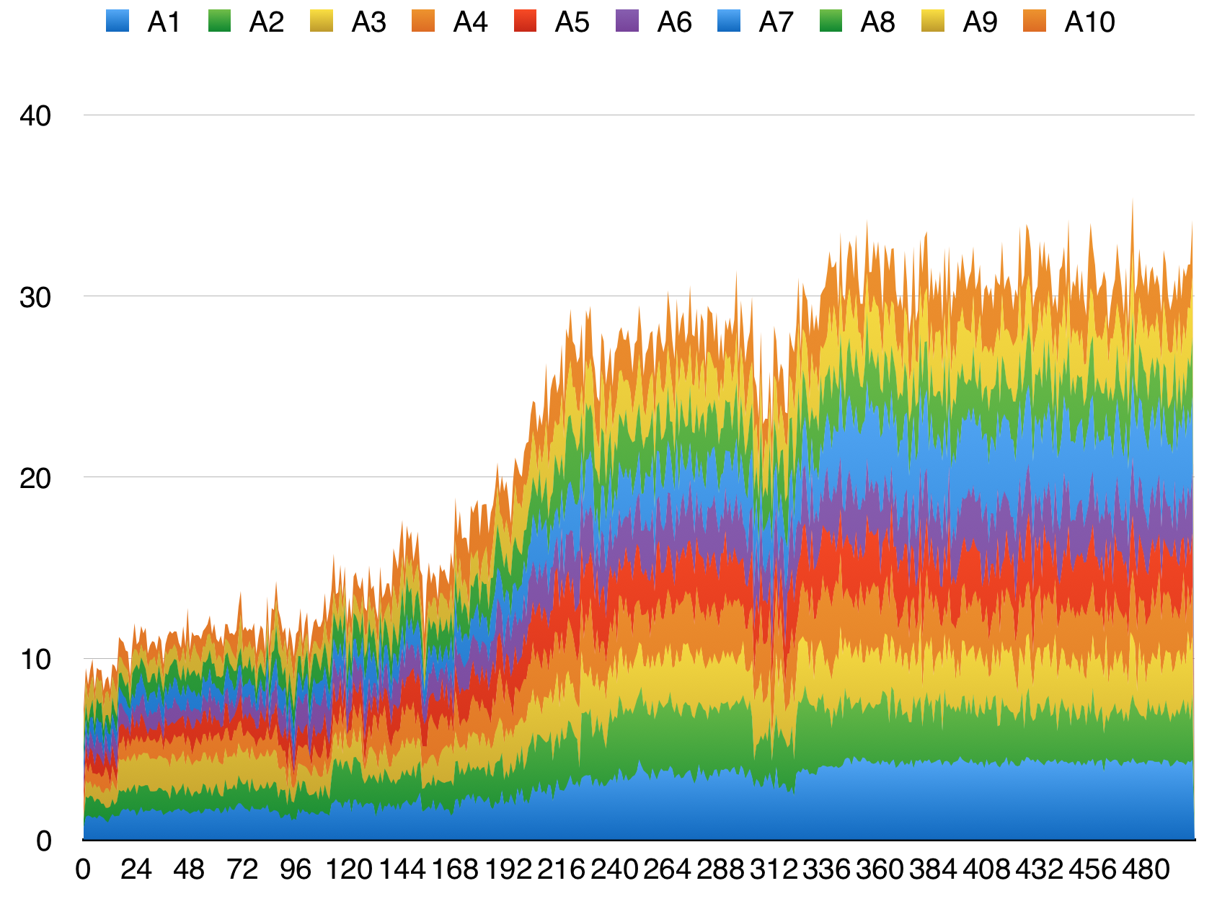
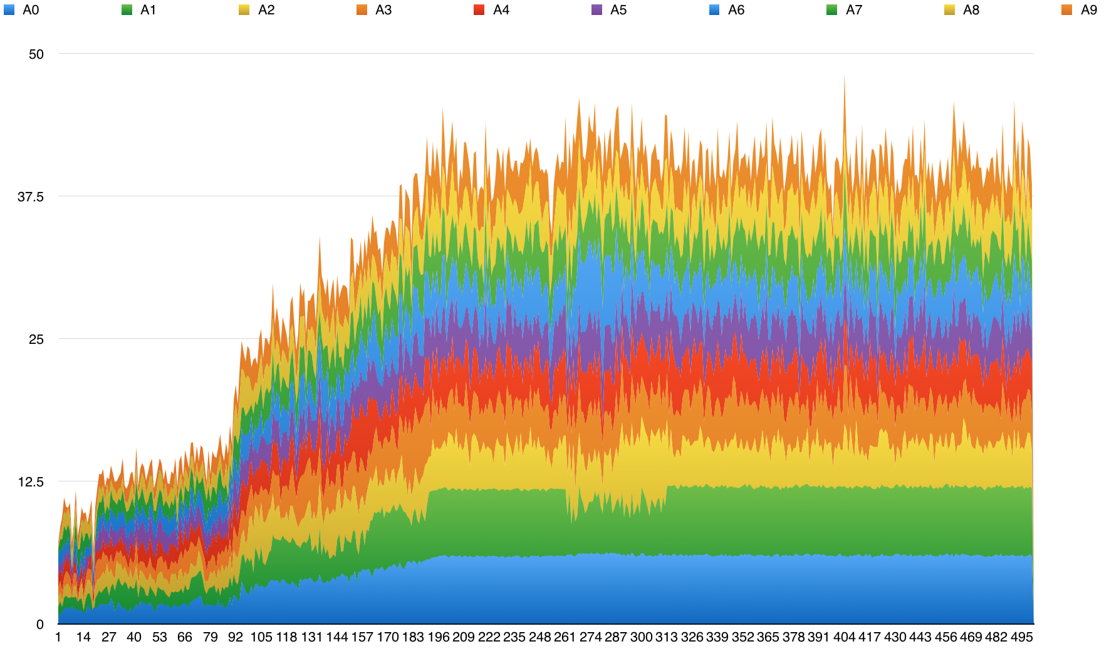
Fitness Score
For each dog (Ax)
per generation
Different fitness formulas and mutations result in different learning speeds

